Slide 1
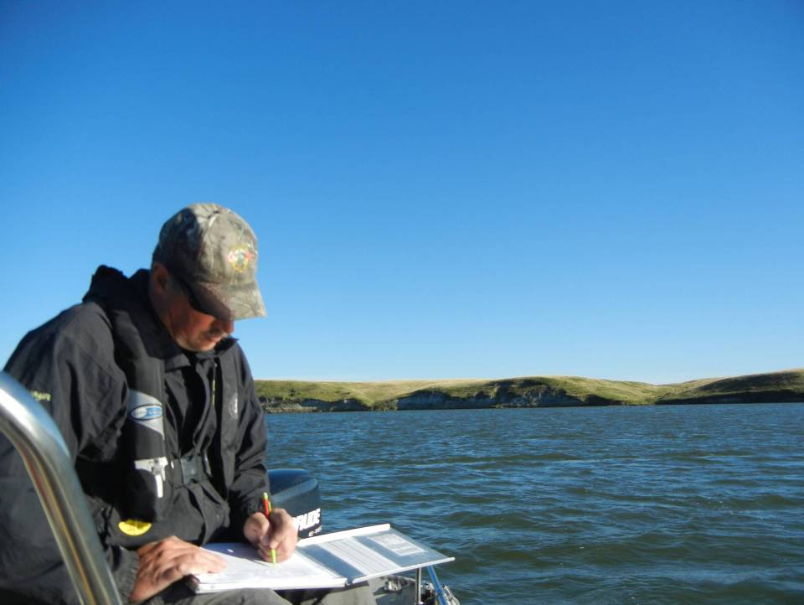

Presentation compiled with unvalidated data.

Slide 2

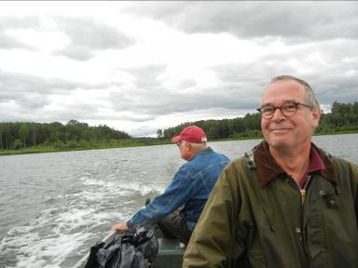
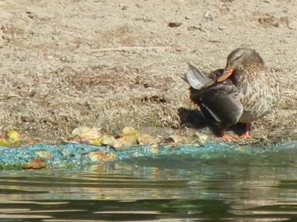
Began in 1991 as a non-profit organization.
Purpose: increasing Albertans’ awareness and understanding of lakes and watersheds.
Goal: improve or maintain the health of lakes and watersheds by engaging Albertans.

Slide 3

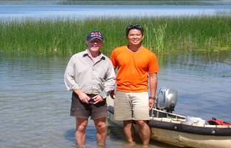
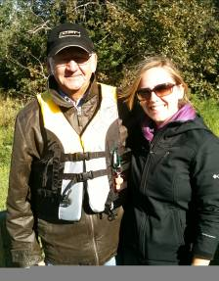
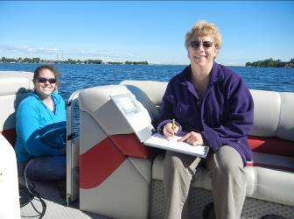
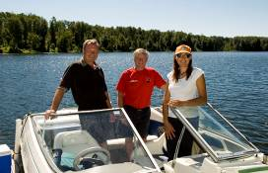
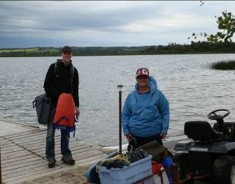
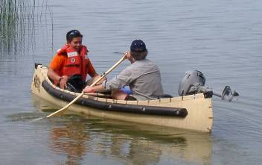
Monitoring program which allows individuals or stewardship groups to track the health of their lake over time.
Volunteers meet technicians 5 times throughout the summer.
Volunteers provide transportation!

Slide 4
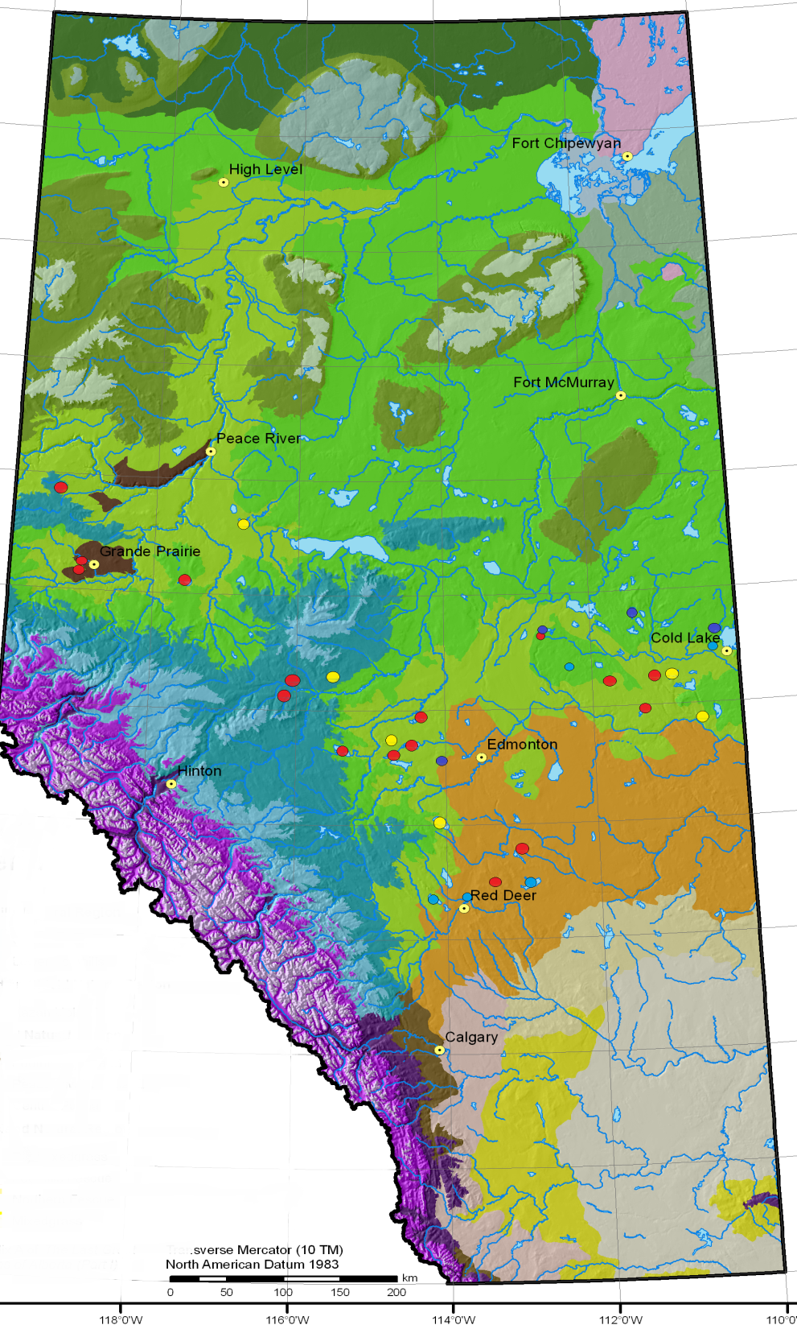
Base Lakes:
Pigeon
Sylvan
Hanmore
Hubbles
Lac Ste. Anne
Lake Isle
Lessard
Little Beaver
Chip
Lower Chain
LICA Lakes:
Marie
Minnie
Moose
Upper Therien
Crane
Laurier
Touchwood
Skeleton North
Skeleton South
Parks/EDF:
Moonshine - Sturgeon
Iosegun - Winagami
Smoke - Bear
McLeod
Saskatoon
Central :
Buffalo
Lacombe
Alix
Red Deer
Glennifer
Notes:
This is a distribution of our lakes sampled in 2014 – we collected data from nearly 30 lakes last summer.

Slide 5
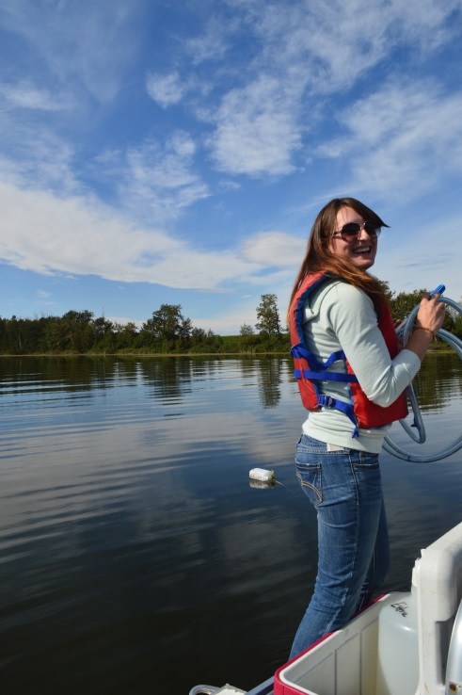
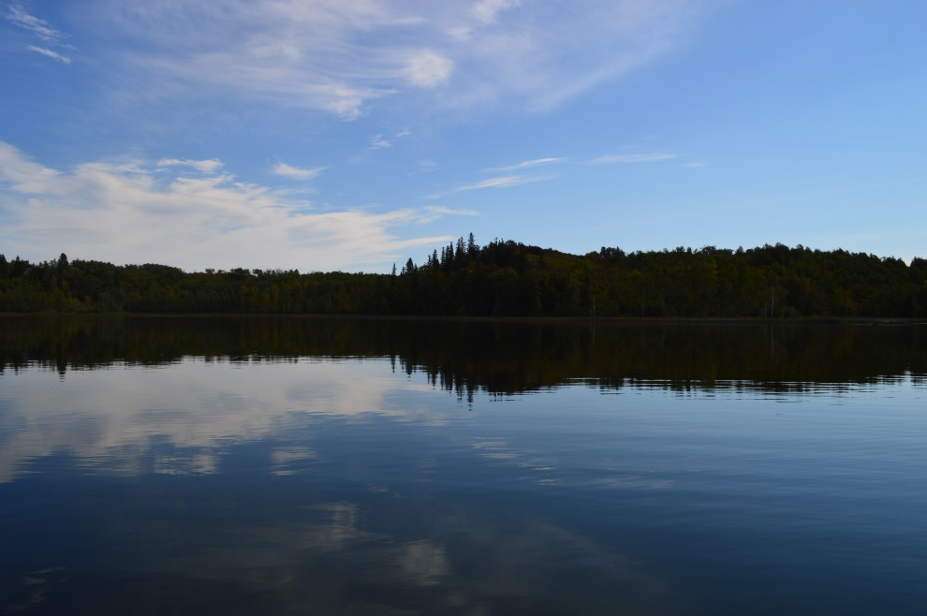
Buffalo Lake 2014:
Sampled four times under the Central Lakes Program in 2014:
  June 26
  July 29
  August 27
  September 24

Slide 6
Temperature:
Observed no thermal stratification.
Maximum: 21.38°C
  Higher temperatures may promote more cyanobacteria growth.
  High temperatures may stress fish species.
Notes:
High water temperatures have been observed across the province in the last decade.

Slide 7
Dissolved Oxygen:
Well oxygenated water column – possibly supersaturated in September.
Recommended guideline for protection of aquatic life is 6.5 mg/L.
Oxygen likely lower at night.
Notes:
Low oxygen concentrations at the sediment-water interface may also contribute to the release of nutrients from the sediments.

Slide 8
Average 1.91m - Eutrophic
Water Clarity:
Measured with a Secchi disk.
In Alberta, blue-green algae/cyanobacteria are generally the primary factor causing reduced water clarity.

Slide 9
Chlorophyll-a 5.7– Oligotrophic
Chlorophyll-a (Green Line):
Indicator of how much phytoplankton (algae/cyanobacteria) is present.
Low average – likely inhibited by saline conditions.

Slide 10
Chlorophyll-a

Slide 11
Phosphorus 41.13 – Eutrophic
Phosphorus (Blue Line:
May drive algae blooms.
TP Maximum: 44 ug/L
Phosphorus enters lakes from the watershed and from internal cycling within the sediments.

Slide 12
Phosphorus

Slide 13
Microcystin
Notes:
Microcystin is the most common toxin produced by cyanobacteria/blue green algae. Species of cyanobacteria in Lower Chain are capable of producing this toxin and caution should be exercised when recreating in blooms of cyanobacteria.

Slide 14
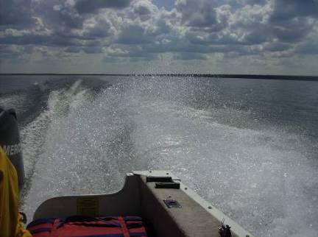
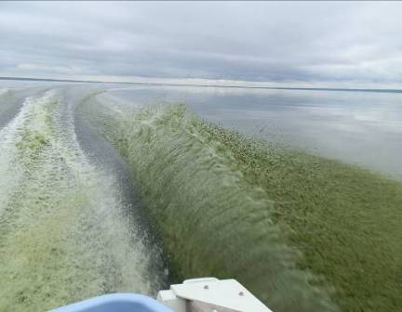
Calling Lake: June
Environmental Influences:
Factors which influence how nutrients are used include:
  Light
  Temperature
  Wind
  Precipitation
Obvious over a summer, but also occurs between years.
Calling Lake: July

Slide 15
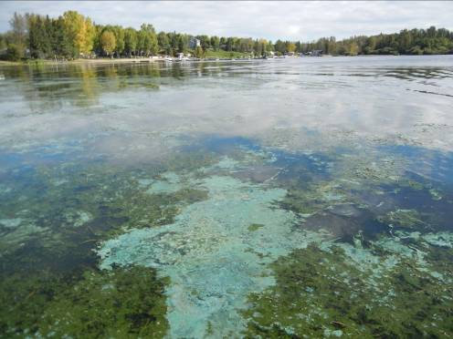

Metals:
ALMS collects information on 29 different metals.
No values exceeded their guidelines.

Slide 16
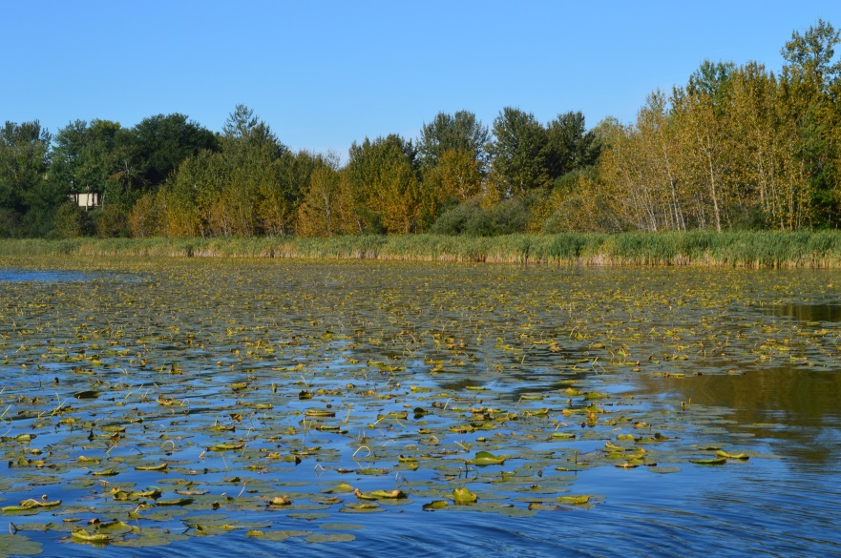
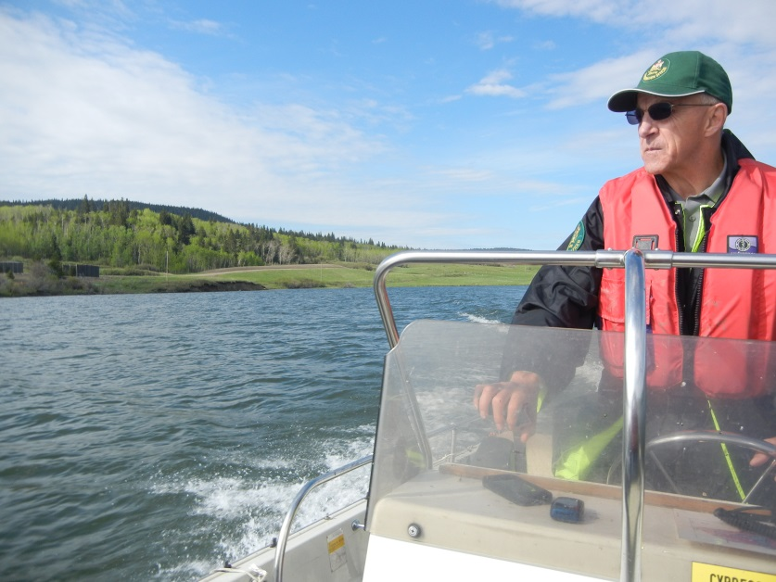
Data Summary:
  High concentrations of phosphorus.
  Low concentrations of phytoplankton.
  Healthy concentrations of dissolved oxygen.
Notes:
It is almost impossible to draw conclusions from only two data points – however, clearly there are high nutrients and high concentrations of biomass within all three basins of the lake.

Slide 17
Parameter Summary
Parameter | 1984 | 1985 | 1986 | 1989 | 1990 | 1992 | 1993 | 1994 | 1995 | 1996 | 1997 | 1998 | 1999 | 2000 | 2001 | 2002 | 2007 | 2014
TP (μg/L) | 64.58 | 45 | 58.4 | 80.34 | 69.2 | 66 | \ | 78.9 | 66.2 | 74.37 | 76.8 | 66.68 | 66.72 | 63.04 | 61.04 | 58.46 | 32 | 41.13
TDP (μg/L) | \ | \ | \ | \ | \ | \ | \ | \ | 35.83 | 36.21 | 38.69 | 34.08 | 33.69 | 34.38 | 35.23 | 32.16 | 12.5 | 25.88
Chlorophyll-a (μg/L) | 9.48 | 6.51 | 6.24 | 14.02 | 12.15 | 10.75 | 19.13 | 4.1 | 8.2 | 12.26 | 12.91 | 12.68 | 17.32 | 8.6 | 10.59 | 5.971 | 7 | 5.7
Secchi depth (m) | 3.35 | 2.25 | 2.88 | 1.57 | 1.98 | 2.1 | 1.367 | 2.05 | 1.97 | 1.67 | 1.72 | 1.86 | 2.23 | 1.97 | 2.5 | 2.11 | 2.2 | 1.91
TKN (μg/L) | \ | 2706 | \ | \ | \ | \ | \ | \ | 2788 | 2455 | 2711 | 2288 | 2107 | 1946 | 2074 | 2248 | 2420 | 2230
NO₂ and NO₃ (μg/L) | 25 | 25 | 25 | 6.25 | 10 | 5.75 | \ | 5 | 8.21 | 13.5 | 19.19 | 10.42 | 15.94 | 12.19 | 9.57 | 5.64 | 2.63 | 5.18
NH₃ (μg/L) | \ | 255.5 | \ | \ | \ | \ | \ | \ | 31.5 | 121 | 55.25 | 40.83 | 51.33 | 53 | 28.57 | 60.43 | 117.5 | 36.1
DOC (mg/L) | \ | \ | \ | \ | \ | \ | \ | \ | 42.45 | 36.55 | \ | 38.4 | 39.5 | 36.85 | 36.1 | 38.8 | 33.95 | \
Ca (mg/L) | 7.67 | 7.2 | 7.4 | 5.48 | 6 | 11.5 | \ | 5 | 4.57 | 5.27 | 6.90 | 6.53 | 5.81 | 7.24 | 6.78 | 5.57 | 7.3 | 9.94
Mg (mg/L) | 73.33 | 89 | 77 | 84.63 | 87 | 77 | \ | 85 | 85.43 | 79.39 | 80.31 | 77.72 | 71 | 75.53 | 76.12 | 71.92 | 67.43 | 74.93
Na (mg/L) | 508.33 | 587 | 520 | 612.25 | 590 | 484.5 | \ | 600 | 603.71 | 579.3 | 574.38 | 534.33 | 508.44 | 573.75 | 531.57 | 629.14 | 519 | 525.75
K (mg/L) | 37.33 | 43.1 | 38.4 | 42.51 | 41.75 | 35.1 | \ | 42.3 | 42.77 | 43.98 | 44 | 40.82 | 40.47 | 41.46 | 42.54 | 41.04 | 38.48 | 43.43
SO₄²⁻ (mg/L) | 411.67 | 442 | 401 | 477.5 | 477.5 | 402 | \ | 495 | 506.57 | 479.4 | 463.63 | 465.17 | 418.67 | 447.5 | 449.29 | 462.14 | 412.5 | 405.25
Cl⁻ (mg/L) | 12.33 | 14.2 | 11.6 | 14.76 | 14.1 | 14.1 | \ | 15.8 | 16.26 | 16.83 | 17.58 | 16.78 | 16.99 | 16.7 | 17.29 | 18.76 | 20.08 | 21.68
CO₃ (mg/L) | \ | 172.68 | 161.52 | 212.25 | 210 | 158 | \ | 199 | 199 | 193.4 | 188.5 | 186.67 | 190.11 | 168.75 | 178.71 | 203.57 | 177 | 176.25
HCO₃ (mg/L) | 976.16 | 1090.97 | 952.76 | 1031.63 | 1004 | 1060 | \ | 1235 | 1048.86 | 1040.8 | 1047.63 | 1012.83 | 972.67 | 957.75 | 936.57 | 1030 | 943 | 950
pH | 9.2 | 9.16 | 9.26 | 9.32 | 9.34 | 9.27 | \ | 9.48 | 9.301 | 9.18 | 9.22 | 9.16 | 9.06 | 9.00 | 9.09 | 9.24 | 9.17 | 9.19
Conductivity (μS/cm) | 2450 | 2848 | 2536 | 2877.5 | 2795 | 2410 | \ | 2850 | 2821.43 | 2870.7 | 2816.43 | \ | 2705.56 | 2495 | 2524.29 | 2770 | 2562.5 | 2600
Hardness (mg/L) | 320 | 383 | 334.2 | 362.13 | 373.5 | 346 | \ | 362 | 363 | 339.8 | 347.75 | 337.33 | 305.22 | 329.5 | 331.43 | 311.86 | 295 | 333.5
TDS (mg/L) | 1676.8 | 1895.16 | 1685.76 | 1957.25 | 1920.5 | 1624.5 | \ | 1951 | 1974.29 | 1916.6 | 1898.13 | 1826.67 | 1731.11 | 1805 | 1775 | 1941.43 | 1705 | 1722.5
Microcystin (μg/L) | \ | \ | \ | \ | \ | \ | \ | \ | \ | \ | \ | \ | \ | \ | \ | \ | \ | 0.16
Total Alkalinity (mg/L CaCO₃) | 1043.67 | 1187.94 | 1050.8 | 1199.88 | 1173.5 | 1001 | \ | 1179 | 1192 | 1177.7 | 1173.75 | 1141.67 | 1114.44 | 1065 | 1065.71 | 1181.43 | 1070 | 1072.5
Notes:
Data summary from all three basins.

Slide 18
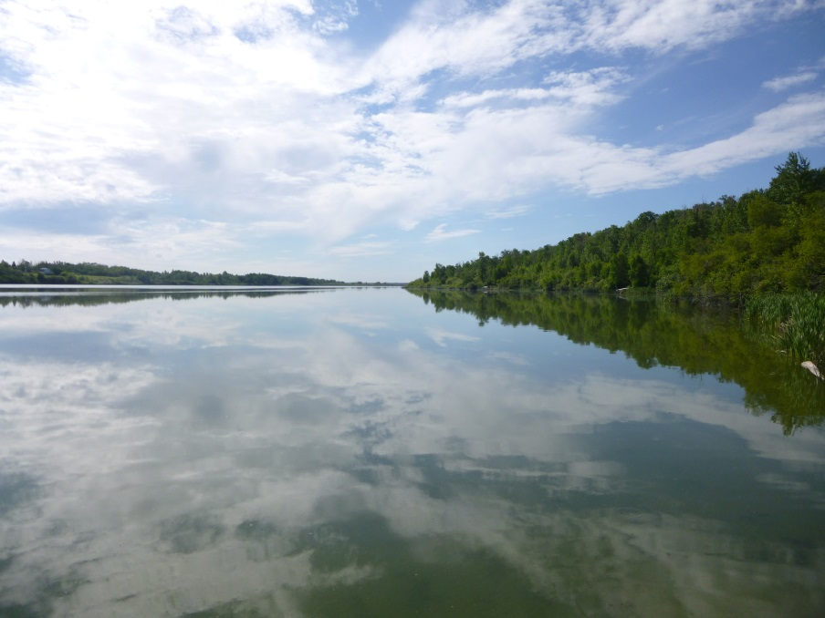
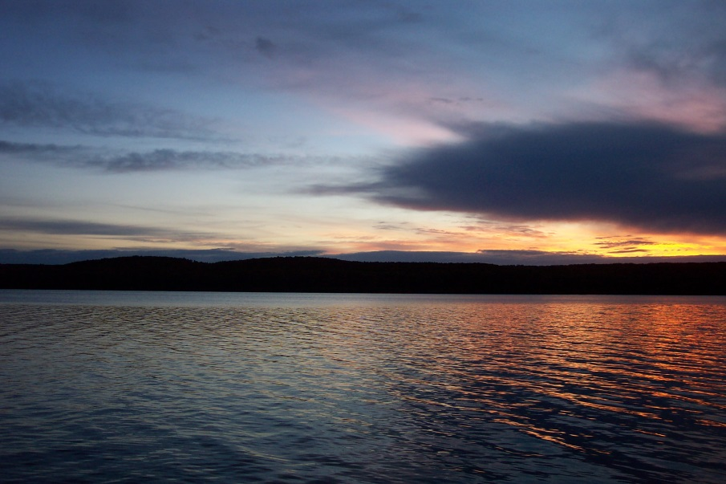
Data compiled into an individual report.
Best way to evaluate a lake’s health – compare a lake to itself, not to other lakes!
Questions to evaluate:
  Have we noticed significant water quality changes in the past 50 years? If so:
    Have there been significant changes to our watershed?
    Have there been changes to our lake levels?
    Has input or output to the lake been modified?
    How has the fishery changed over time? Overfishing? Fish stocking?

Slide 19
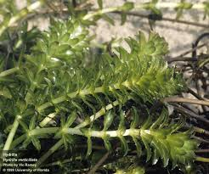
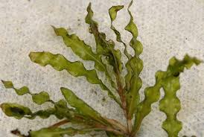
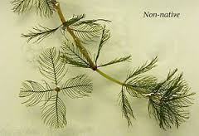
Invasive Macrophytes:
Three main species of concern:
  Eurasian Water Milfoil
  Hydrilla
  Curly Leaf Pondweed
These species enter lakes via boat traffic and aquariums.
Form dense monocultures – impede recreation and destroy fish habitat.

Slide 20
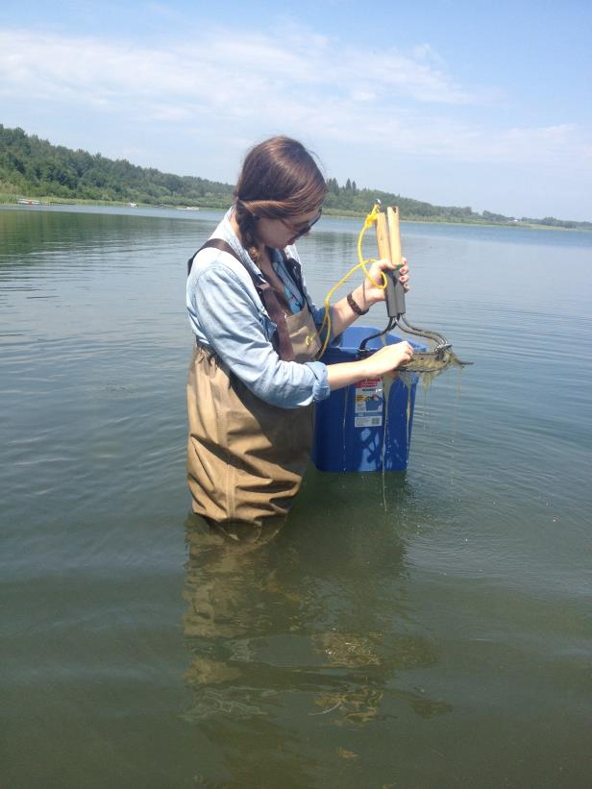
Invasive Macrophytes:
Attend an invasive plant identification workshop!
Conduct a bio-blitz at your lake alongside ALMS!
Contact Alyssa at:
  acloutie@ualberta.ca
  780-415-9785
  for more information.

Slide 21
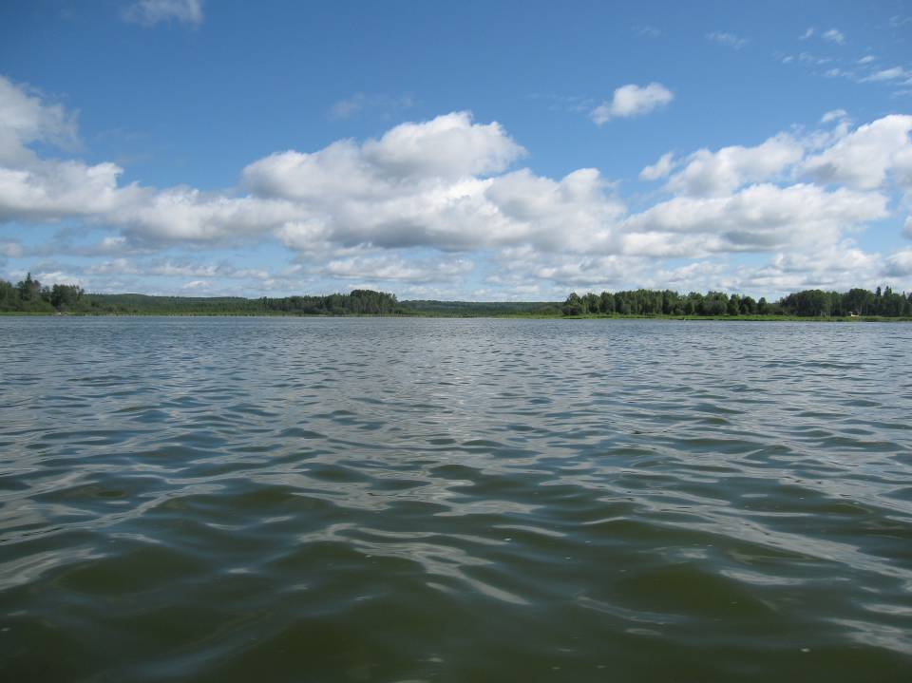
Questions?
Questions?

